Slide 1
Improving wheat gene annotation
David Swarbreck

Slide 2
A timeline of wheat annotations
Release of a draft gene centric assembly. Comparison against data from other grass species estimates the number of wheat genes to be around 96,000.
2012
Annotation of a draft whole-genome reference for wheat. The annotation contains almost one million gene models, of which 124,201 (13%) are deemed of high confidence.
2013
The release of a complete pseudomolecule for chromosome 3B its annotation contains only 5099 coding genes, 2165 pseudogenes and 117 long non-coding RNAs
2014
The TGACv1 annotation identifies 217,907 loci, of which 114,247 are high confidence.
2016

Slide 3
Input datasets for the TGACv1 annotation
The TGACv1 annotation was based on the following sets of data:
Two public available Illumina datasets, already employed for the definition of the previous annotation, containing over 2 billion paired-end reads across multiple tissues and conditions.
An internally generated Illumina dataset, containing over 800 million strand-specific Illumina reads, to complement the public datasets with last-generation Illumina data.
Over one million and a half PacBio full length cDNAs, derived from six different tissues, to define transcript structures with the highest possible accuracy.
Protein models from six different species, for a total of over three hundred thousand sequences, to aid in annotating loci not expressed in any of the above datasets.

Slide 4
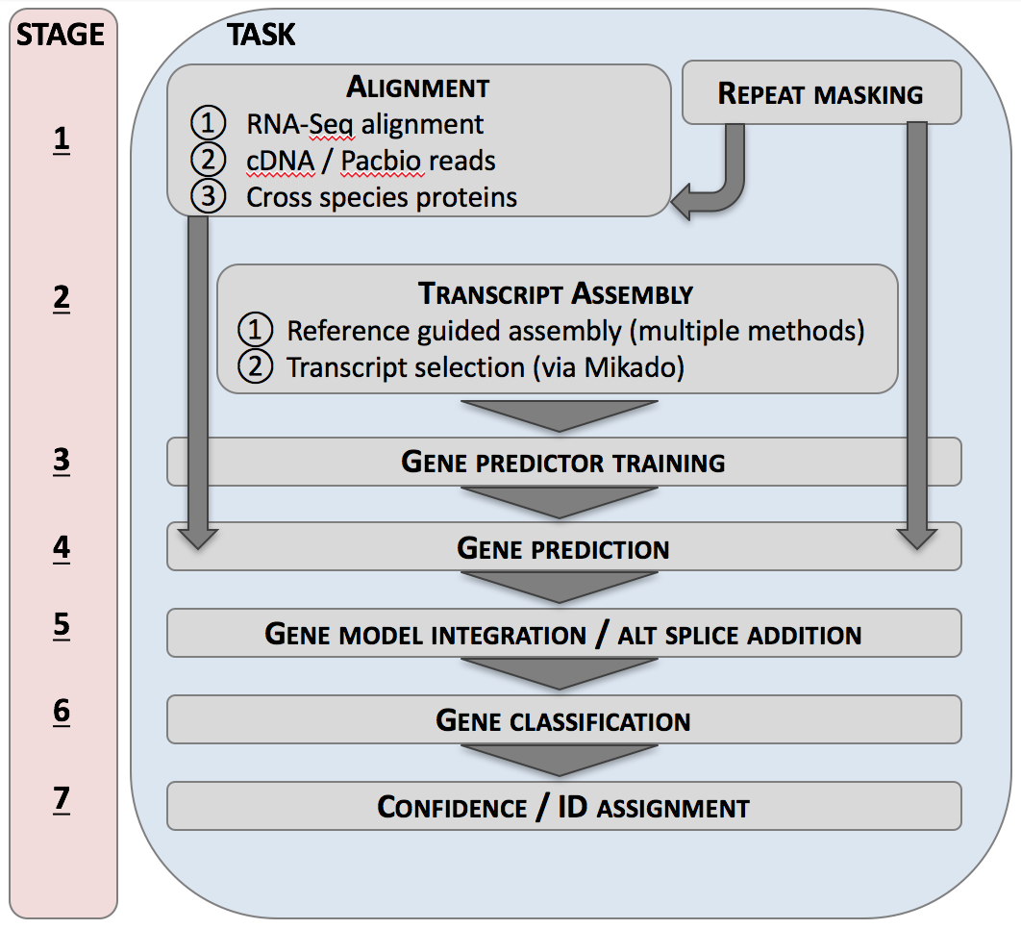
Gene annotation pipeline

Slide 5
Gene annotation pipeline
STAGE 2 Transcript Assembly
11 million Illumina assemblies and 1.5 million PacBio transcripts.
Identify a filtered set of “best” assemblies giving ~273,000 genes ~374,000 transcripts

Slide 6
Gene annotation pipeline
STAGE 3 Gene predictor training
Training utilised a sub-set of ~10,000 PacBio transcripts
Identified as likely full-length
Excluding potential chimeric transcripts
With 5’ and 3’ UTR

Slide 7
Gene annotation pipeline
STAGE 4 Gene prediction
Protein coding genes were predicted using AUGUSTUS by means of a Generalized Hidden Markov Model (GHMM) that takes both intrinsic and extrinsic information into account

Slide 8
Gene annotation pipeline
STAGE 5 Gene model refinement
Addition of alternative splice variants
Removal of unsupported gene models
217,907 loci and 273,739 transcripts identified

Slide 9
Gene classification
The genes in the TGAC v1 gene set are assigned to 4 biotypes:
Protein coding
ncRNA (long non-coding RNA)
Protein coding repeat associated
ncRNA repeat associated
Non-coding RNA classification
Little or no protein homology (coverage below 30%)
Low coding potential (coding potential calculator, CPC v. 0.9.2)
Repeat association
Sequence homology to proteins encoded by transposable elements (TransposonPSI)
Overlap with annotated interspersed repeats (PGSB group, Klaus Mayer)

Slide 10
Gene confidence assignment
Each transcript is assigned a confidence rank based on:
Cross species protein homology (protein ranking)
Wheat transcript support (transcript ranking)
Protein Ranking
Based on BLAST alignment (UniProt and Brachypodium distachyon, Oryza saliva, Zea mays, Sorgum bicolour, Setaria italic and Arabidopsis thaliana proteins).
P1 = Classed as full length based on UniProt BLAST or greater than 80% coverage of a reference protein.
P2 = >= 60% coverage P3 = 30 – 60% coverage
P4 = 0 – 30% coverage
P5 = no coverage

Slide 11
Gene confidence assignment
Each transcript is assigned a confidence rank based on:
Cross species protein homology (protein ranking)
Wheat transcript support (transcript ranking)
Transcript Ranking
Based on support from the 11 million illumina transcripts and 1,330,372 high quality aligned PacBio transcripts.
T1 = full support from PacBio transcript or riken cDNA
T2 = full support from illumina transcript assembly
T3 = Annotation edit distance (AED) < 0.5 T4 = AED 0.5 - 1
T5 = no support

Slide 12
Gene classification and confidence assignment
We then use the transcript and protein rankings to determine a simple gene level classification of high and low confidence.
Gene models with > 60% protein coverage (i.e. P1 and P2) were assigned as high confidence when the model had some transcript support.
Repeat associated gene models were classed as low confidence.
Low confidence genes will include gene fragments and pseudogenes.

Slide 13
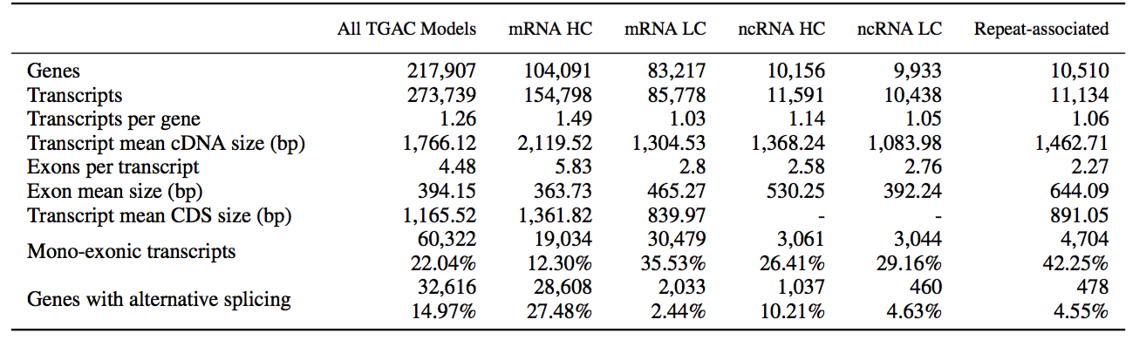
Summary - TGACv1 gene annotation
A total of 217,907 loci and 273,739 transcripts were identified.
We assigned 104,091 coding genes and 10,156 long non-coding RNA as high confidence (HC)
Low confidence genes are shorter, more likely to be single exon and have fewer splice variants annotated than the high confidence set.

Slide 14
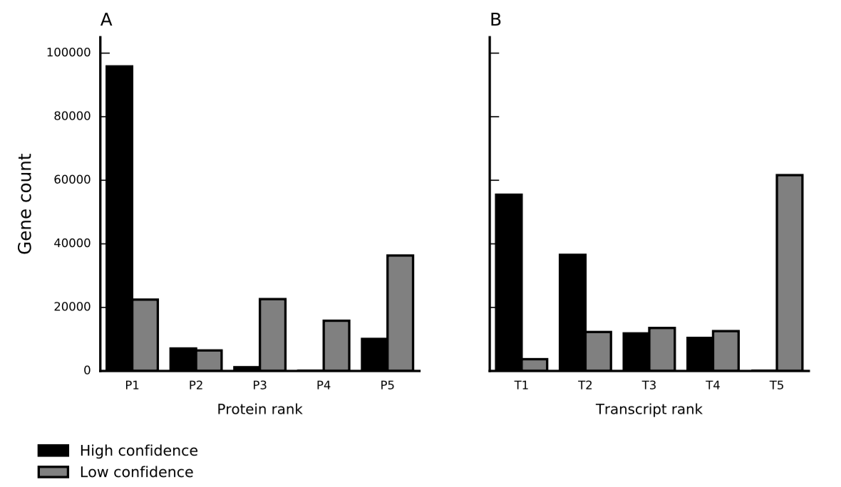
A large proportion of high confidence genes are fully supported by protein and transcript data.
92% of high confidence coding genes classed as P1 (>80% coverage)
50% of high confidence coding genes fully-supported by Pacbio

Slide 15
A large proportion of high confidence genes are fully supported by protein and transcript data.
79% of high confidence coding genes fully-supported by Pacbio or Illumina assemblies (T1 + T2)
92% of high confidence coding genes classed as P1 (>80% coverage)

Slide 16
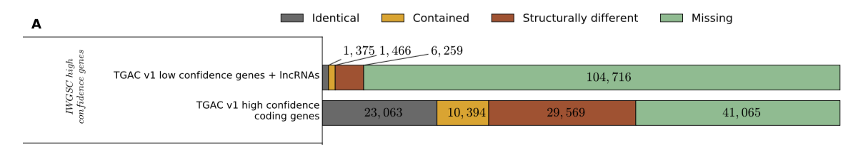

A more comprehensive and accurate wheat annotation
We aligned the CSS/3B (IWGSC) gene models to the TGACv1 assembly and compared against the TGACv1 gene models.
IWGSC High confidence genes
TGACv1 LC genes
V
TGACv1 HC genes
Percentage of genes
Of the TGACv1 high confidence (HC) genes, 61% overlapped with an aligned IWGSC HC gene

Slide 17
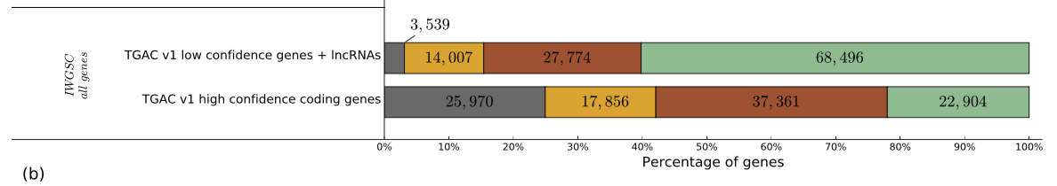
A more comprehensive and accurate wheat annotation
We aligned the CSS/3B (IWGSC) gene models to the TGACv1 assembly and compared against the TGACv1 gene models.
V
TGACv1 LC genes
All IWGSC
TGACv1 HC genes
Percentage of genes
Of the TGACv1 high confidence (HC) genes, 78% overlapped with the full set of IWGSC genes (LC + HC).

Slide 18
A more comprehensive and accurate wheat annotation
We aligned the CSS/3B (IWGSC) gene models to the TGACv1 assembly and compared against the TGACv1 gene models.
V
TGACv1 LC genes
All IWGSC
TGACv1 HC genes
Percentage of genes
22,904 genes (22%) high confidence TGACv1 without a match in the full set of IWGSC genes.
Of which 19 810 (86 %) have cross species protein similarity support with 6665 (29 %) fully supported by a PacBio transcript

Slide 19
A more comprehensive and accurate wheat annotation
We aligned the CSS/3B (IWGSC) gene models to the TGACv1 assembly and compared against the TGACv1 gene models.
V
TGACv1 LC genes
All IWGSC
TGACv1 HC genes
Percentage of genes
A larger percentage of low confidence genes lack a match in the IWGSC gene set (~60%).
13 609 TGACv1 genes are fragmented in the IWGSC gene set.

Slide 20
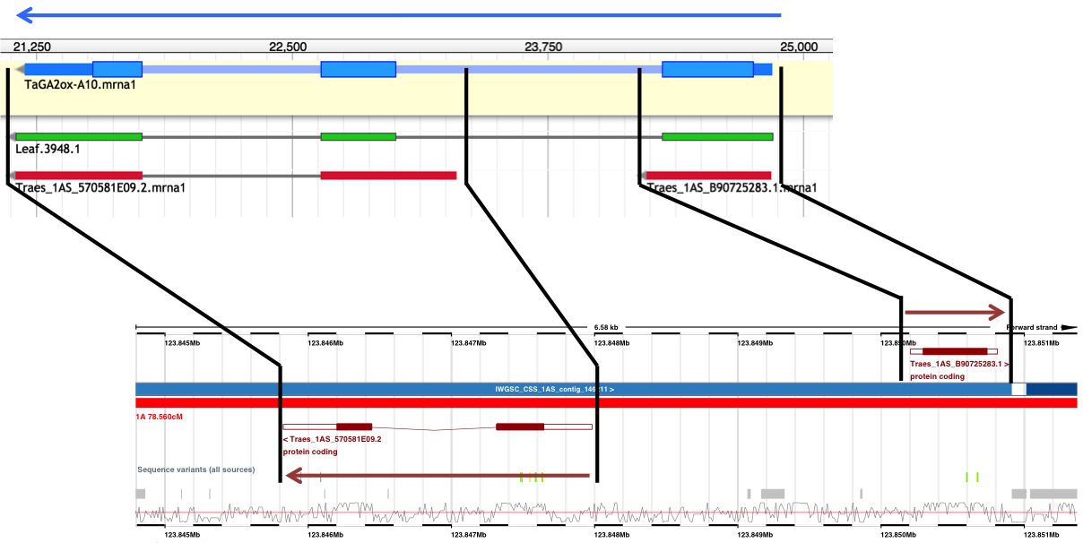
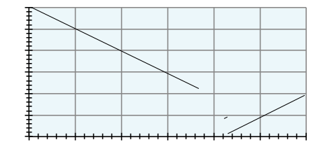
Improved representation of gibberellin biosynthetic genes
The gibberellin (GA) pathway plays a central role in the regulation of plant development.
72 genes in the pathway, only 23 genes (32%) are found as full-length sequences in IWGSC, whereas 67 of them (93%) are identified in TGACv1
A) GA2ox10 (1AS) is incorrectly represented as two genes (*) on opposite strands in the IWGSC CSS assembly
B) IWGSC (CSS) assembly shows a inversion relative to the TGACv1 assembly in the region covering exon 1 of GA2ox10 (1AS)
TGACv1 Assembly
GA2ox10 (1AS)
IWGSC (CSS) scaffold
Assembled transcript
IWGSC (CSS) genes
TGACv1 Scaffold
IWGSC CSS Assembly
(Ensembl)
*
*

Slide 21
Data access
Data files can be downloaded from
The Earlham open data site
http://opendata.earlham.ac.uk/Triticum_aestivum/TGAC/v1/annotation/
Files provided:
TGACv1 annotation, in GFF3 format
Sequences for the transcript models of TGACv1 cDNAs, CDS and proteins
Functional annotation of TGACv1 genes
Annotation of alternative splicing events
Mapping file linking TGACv1 genes to IWGSC annotation
Ensembl Plants
http://plants.ensembl.org/Triticum_aestivum

